Slide 1
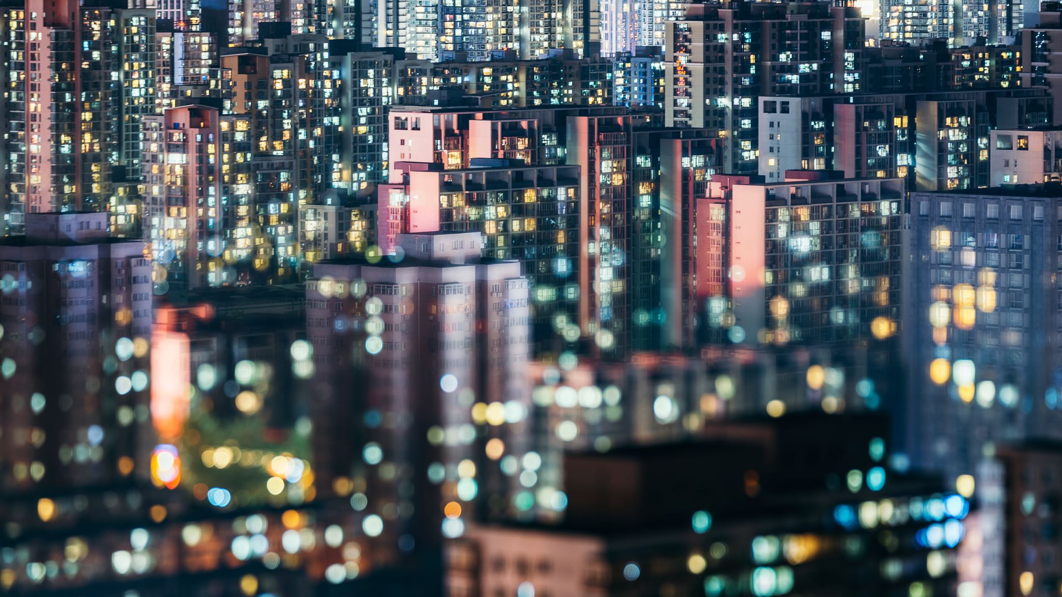
Identification of Cities for Foodies

Slide 2
Identifying cities for Foodies is good for business
A foodie is a person who eats food not only out of hunger but due to their interest or hobby [1]
In 2014 the food marketing system supplied about $1.46 trillion worth of food [2]
The food marketing business has pushed cities around the world to develop their restaurant industry to become diverse and plentiful
This exploration will be useful for foodies looking to travel to cities on their next adventure or for the cities looking to bring in more tourism

Slide 3
Data Acquisition and Cleaning
US city data was scraped from https://en.wikipedia.org/wiki/List_of_United_States_cities_by_population
This dataset was refined to show only population density and land area for the cities and sorted by each of these categories
Baltimore was picked as the first city and the sorted data was used to find similar cities from both categories
These cities are Seattle, WA and Milwaukee, WI

Slide 4
Data Acquisition and Cleaning (cont.)
Zip code data with longitudes and latitudes was imported from https://public.opendatasoft.com/explore/dataset/us-zip-code-latitude-and-longitude/table/
The longitudes and latitudes of each zip code were used to pull Foursquare venue data
This venue data was refined to show only food related venues (using the category data) and was rid of duplicates
Each food category was given a numeric label and was used to map the different types of categories

Slide 5
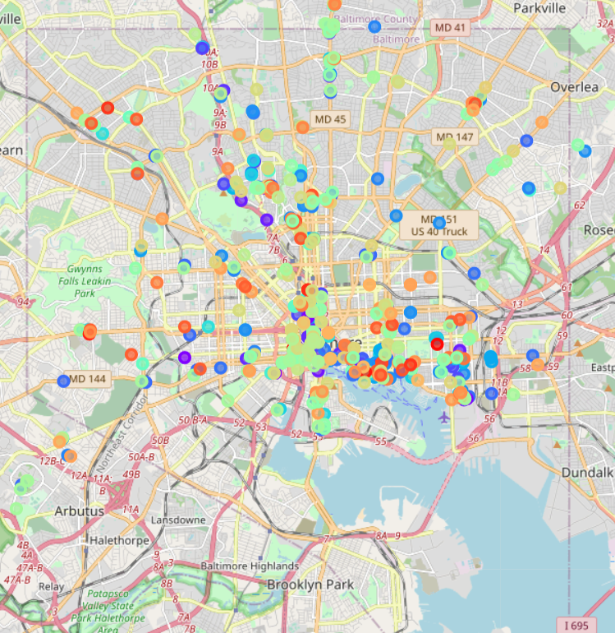
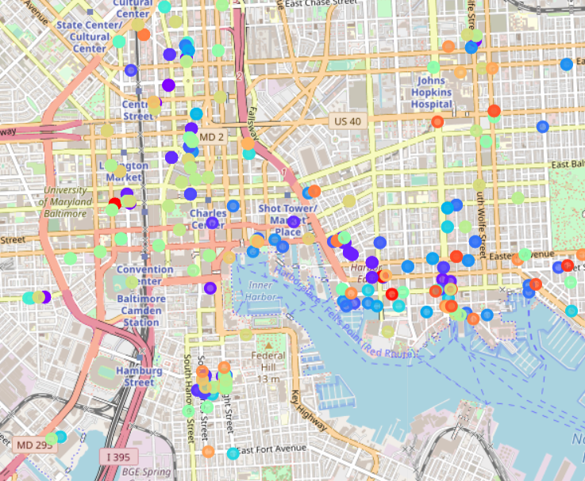
Baltimore Food Venue Map

Slide 6
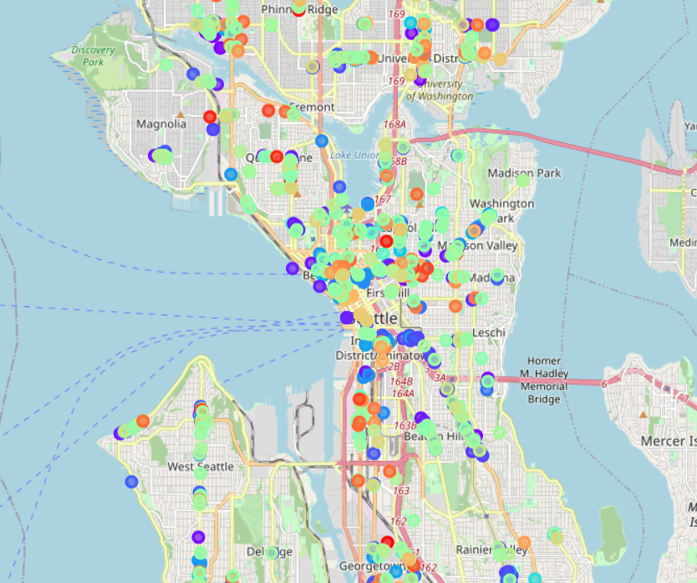
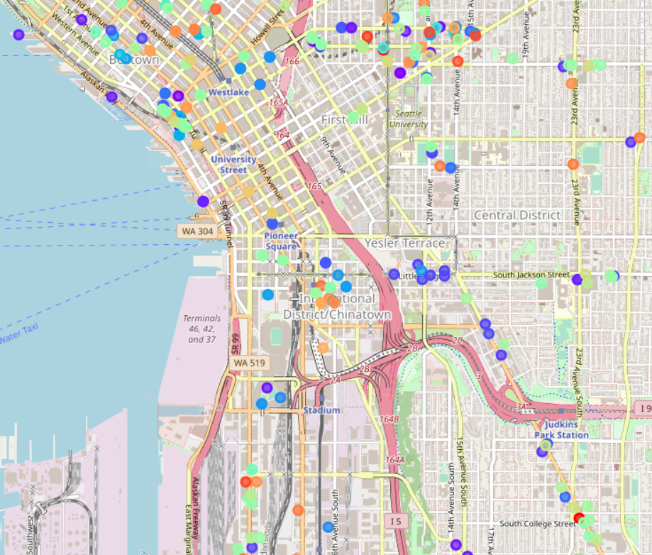
Seattle Food Venue Map

Slide 7
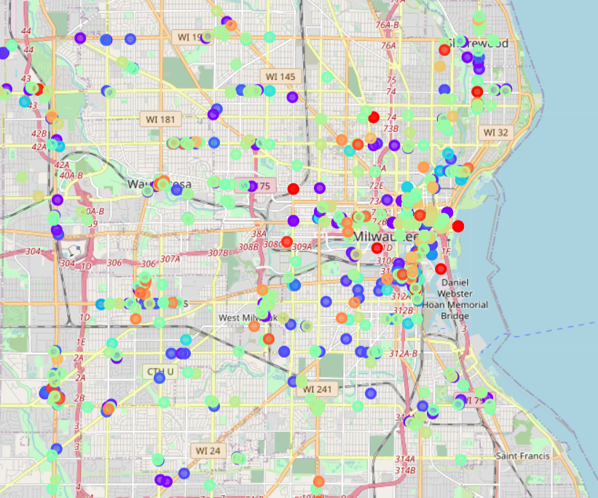
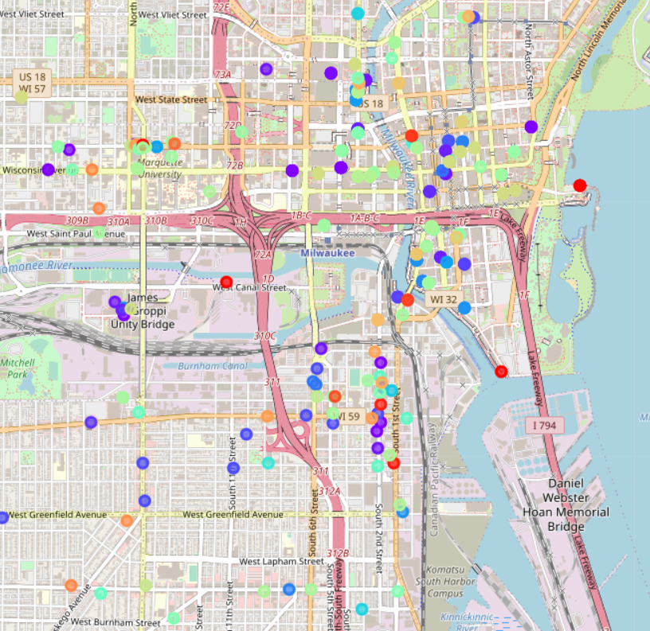
Milwaukee Food Venue Map

Slide 8
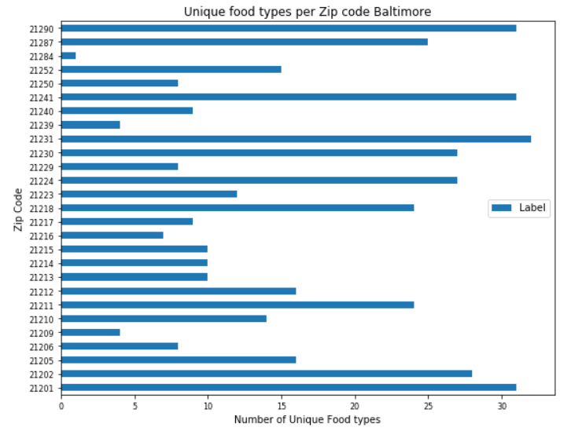
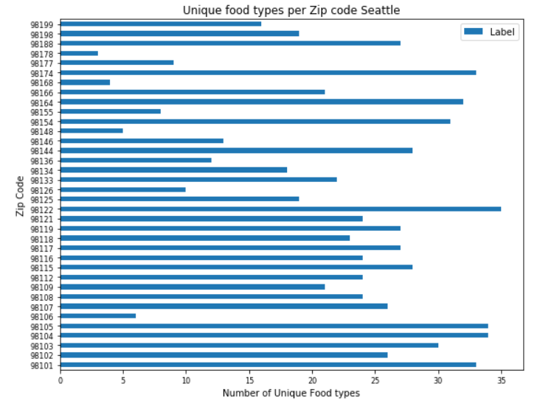
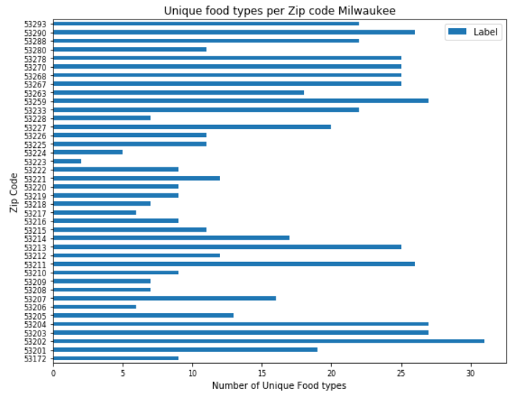
Unique food venues per city
Zip codes with > 20 unique venues:
37% 63.9% 35%

Slide 9
Discussion and Conclusion
By using Foursquare data, venues with a food category were identified and mapped
The zip codes were plotted versus the number of unique types of food categories they contained and normalized based on number of zip codes in the city
Seattle had the highest percentage of zip codes with more than 20 different types of food venues at 63.9%, Baltimore had 37% and Milwaukee had 35%
This data shows that a Foodie would be wise to travel to Seattle on their next adventure and Milwaukee and Baltimore should attract more diverse restaurants to increase tourism

